Slide 1

“INTRUSION DETECTION OF IMBALANCED NETWORK TRAFFIC BASED ON MACHINE LEARNING AND DEEP LEARNING”
BANGALORE INSTITUTE OF TECHNOLOGY K. R. Road, V. V. Pura, Bengaluru – 560004 Department of Computer Science and Engineering
By:
Prathiksha P H (1BI18CS114)
Under the Guidance
of
Dr. Maya B S
Assistant Professor
Dept. of CSE

Slide 2
AGENDA
Introduction
Literature Review
Problem Statement
Proposed System
Architecture
Methodology/Algorithm
Results( Graph/Tables)
Applications
Conclusion
References.

Slide 3
INTRODUCTION
With the rapid development network become more complex and massive, cyber-attacks have also become complex .
network-based services and sensitive information on networks, network security is getting more and more importance than ever.
The human labelling of the available network audit data instances is usually tedious, time consuming and expensive.
Network Intrusion Detection System (NIDS) needs to accurately identify malicious network attacks, provide real-time monitoring and dynamic protection measures, and formulate strategies.

Slide 4
LITERATURE REVIEW
SL.No | Title | Author | Year of Publication | Adopted Methodology | Limitations
1 | ‘‘A deep learning approach for network intrusion detection system,’’ | A. Javaid, Q. Niyaz, W. Sun, and M. Alam | 2016 | It propose a deep learning based approach for developing such an efficient and flexible NIDS. Here we use Self-taught Learning (STL), a deep learning based technique, on NSL-KDD | -

Slide 5
LITERATURE REVIEW
SL.No | Title | Author | Year of Publication | Adopted Methodology | Limitations
2 | ‘‘Malware traffic classification using convolutional neural network for representation learning,’’ | W. Wang, M. Zhu, X. Zeng, X. Ye, and Y. Sheng | 2017 | This proposed a malicious software traffic classification algorithm based on Convolutional Neural Network (CNN). By mapping the traffic characteristics to pixels, the network traffic image is generated, and the image is used as the input of the CNN to realize traffic classification.

Slide 6
SL.No | Title | Author | Year of Publication | Adopted Methodology | Limitations
3 | ‘‘Intrusion detection using a novel hybrid method incorporating an improved KNN,’’ | H. Shapoorifard and P. Shamsinejad | 2017 | SNIDS based are detected on pattern matching, whereas the ADNIDS are detected based on hybrid method CANN. one-dimensional distance based feature which will be used to represent each data sample for intrusion detection by k-nearest neighbor (KNN) along with k-farthest neighbor (k-FN) classifier.

Slide 7
SL.No | Title | Author | Year of Publication | Adopted Methodology | Limitations
4 | ‘‘A survey of deep learning-based network anomaly detection,’’ | D. Kwon, H. Kim, J. Kim, S. C. Suh, I. Kim, and K. J. Kim | 2019 | carried out relevant research on the deep learning model, focusing on data simplification, dimension reduction, classification, and other technologies, and proposes a Fully Convolutional Network(FCN) model. By comparing with the traditional machine learning technology, it is proved that the FCN model is useful for network traffic analysis

Slide 8
SL.No | Title | Author | Year of Publication | Adopted Methodology | Limitations
5 | ‘‘A Hybrid Approach for Network Intrusion Detection,’’ | Mavra Mehmood , Talha Javed, Jamel Nebhen, Sidra Abbas, Rabia Abid, Giridhar Reddy Bojja and Muhammad Rizwan | 2021 | This paper proposes a new hybrid method for intrusion detection and attack categorization. the random forest recursive feature elimination method is applied to identify optimal features that positively impact the model’s performance. we use various Support Vector Machine (SVM) types to detect intrusion and the Adaptive NeuroFuzzy System (ANFIS) to categorize probe, U2R, R2U, and DDOS attacks.

Slide 9
PROBLEM STATEMENT
“To implement Intrusion detection of imbalanced network traffic based on Machine learning and Deep learning.”
Objectives:
To prevent Intrusion in the network across the cyberspace.
To provide privacy and security for the network system and to manage reputation managed protection.

Slide 10
PROPOSED SYSTEM
We use the classic NSL-KDD and the up-to-date CSECIC-IDS2018 as benchmark datasets and conduct detailed analysis and data cleaning.
This work proposes a novel DSSTE algorithm, reducing the majority samples and augmenting the minority samples in the difficult set, tackling the class imbalance problem in intrusion detection so that the classifier learns the differences better in training.
The classification model uses Random Forest (RF), Support Vector Machine (SVM), XGBoost, Long and Short Time Memory (LSTM), AlexNet, Mini-VGGNet. Comparing with other methods, we divide the experiment into 30 methods

Slide 11
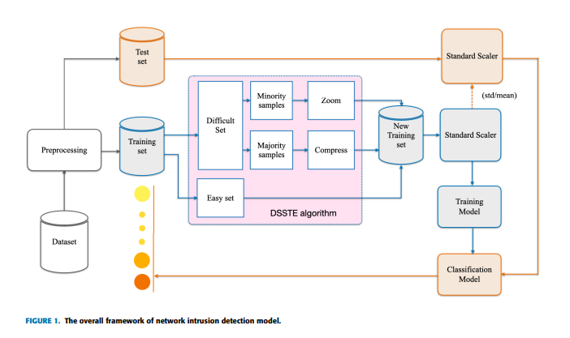
ARCHITECTURE
Note:
Block diagram / main architecture
Module Descriptions, if any

Slide 12
ALGORITHM / METHDOLOGY
DSSTE Algorithm Input: Imbalanced training set S, scaling factor K
Output: New training set SN
1: Step1: Distinguish easy set and difficult set
2: Take all samples from S and set it as SE
3: for each sample ∈ SE do
4: Compute its K nearest neighbors
5: Remove whose most K nearest neighbor samples are of different classes from SE
6: end for
7: Easy set SE, difficult set SD = S − SE
8: Step2: Compress the majority samples in difficult set by the cluster centroid
9: Take all the majority samples from SD and set it as SMaj
10: Use KMeans algorithm with K cluster
11: Use the coordinates of the K cluster centroids replace the majority samples in SMaj
12: Compressed the majority samples set SMaj
13: Step3: Zoom augmentation

Slide 13
14: Take the minority samples from SD and set it as SMin
15: Take the Discrete attributes from SMin and set it as XD
16: Take the Continuous attributes from SMin and set it as XC
17: Take the Label attributes from SMin and set it as Y
18: for n ∈ range(K,K + number SMin.shape[0]) do // zoom range is [1 − 1 K , 1 + 1 K ], SMin.shape[0] is number of samples in SMin
19: XD1 = XD
20: XC1 = XC × (1 − 1 n )
21: XD2 = XD
22: XC2 = XC × (1 + 1 n )
23: SZ append [concat(XD1, XC1, Y ), concat(XD2, XC2, Y )]
24: end for
25: New training set SN = SE + SMaj + SMin + SZ

Slide 14
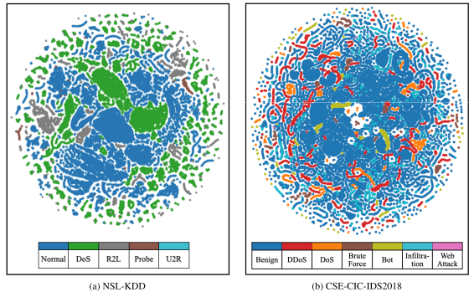
RESULTS

Slide 15
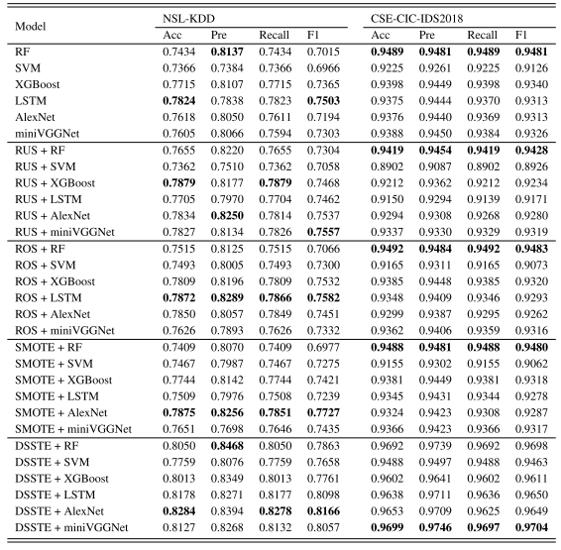

Slide 16
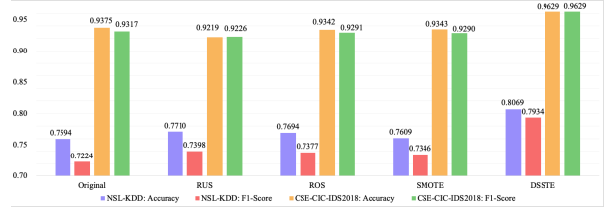

Slide 17
APPLICATIONS
To prevent Intrusion in the network across the cyberspace.
To provide privacy and security for the network system and to manage reputation managed protection.

Slide 18
CONCLUSION
Summary:
It is found that deep learning performance is better than machine learning after sampling the imbalanced training set samples through the DSSTE algorithm Hence the Paper considers to make use of mini VGGnet.
Limitations:
Although the neural networks strengthen data expression, the current public datasets have already extracted the data features in advance, which is more limited for deep learning to learn the preprocessed features and cannot take advantage of its automatic feature extraction
Future Enhancements:
. Therefore, in the next step, we plan to directly use the deep learning model for feature extraction and model training on the original network traffic data, performance the advantages of deep learning in feature extraction, reduce the impact of imbalanced data and achieve more accurate classification

Slide 19
REFERENCES
[1]A. Javaid, Q. Niyaz, W. Sun, and M. Alam, ‘‘A deep learning approach for network intrusion detection system,’’ in Proc. 9th EAI Int. Conf. Bioinspired Inf. Commun. Technol. (Formerly BIONETICS), 2016, pp. 21–26.
[2] W. Wang, M. Zhu, X. Zeng, X. Ye, and Y. Sheng, ‘‘Malware traffic classification using convolutional neural network for representation learning,’’ in Proc. Int. Conf. Inf. Netw. (ICOIN), 2017, pp. 712–717.
[3] H. Shapoorifard and P. Shamsinejad, ‘‘Intrusion detection using a novel hybrid method incorporating an improved KNN,’’ Int. J. Computing. Appl., vol. 173, no. 1, pp. 5–9, Sep. 2017
[4] D. Kwon, H. Kim, J. Kim, S. C. Suh, I. Kim, and K. J. Kim, ‘‘A survey of deep learning-based network anomaly detection,’’ Cluster Computing.,vol. 22, pp. 949–961, 2019
[5] Mavra Mehmood , Talha Javed, Jamel Nebhen, Sidra Abbas, Rabia Abid, Giridhar Reddy Bojja and Muhammad Rizwan, ‘‘A Hybrid Approach for Network Intrusion Detection,’’ vol 70,No 1, Sept 2021

Slide 20
[6] Intrusion Detection of Imbalanced Network Traffic Based on Machine Learning and Deep Learning. December 30, 2020(Base Paper).

Slide 21
THANK YOU

